Slide 1
How to Serve in a Restaurant
Stephanie Freas

Slide 2
Understanding serving
This presentation is helpful if you:
want to become a server
are a server and would like pointers
want to understand how people should be serving you
are going into a service profession (libraries!)

Slide 3
Four Pillars of Serving
Attitude
Appearance
Knowledge
Efficiency

Slide 4
Attitude
Smile
Sincerity
Build repertoire
Professionalism

Slide 5
Appearance
Clean, appropriate uniform
Well-groomed
Follow guidelines set by restaurant

Slide 6
Knowledge
Menu
Specials
Unique orders
Recommendations

Slide 7
Efficiency
Anticipate needs
Ask questions
Confirm requests
Be timely

Slide 8
Greeting
~30 seconds
“Hi… My name is Stephanie and I’ll be taking care of you today. So, what brings you to our restaurant? Have you been here before?”
Time to build relationship
Offer drinks and take orders.
Notes:
Celebration: “Happy birthday! Thanks for celebrating with us.”
Lunch: “Wonderful. Would you like a quick lunch to get back to work?”

Slide 9
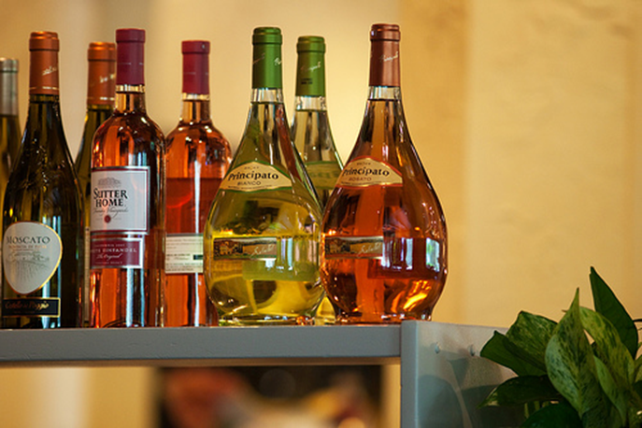
Drinks and Ordering
~2 minutes
Address appetizers
Mention daily specials or new items
Offer recommendations
Take and repeat orders

Slide 10
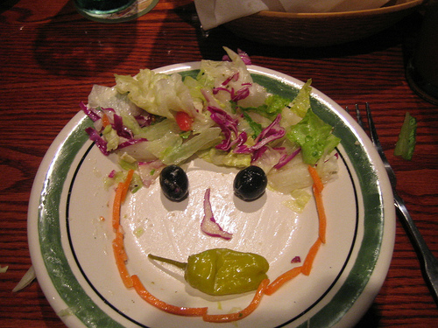
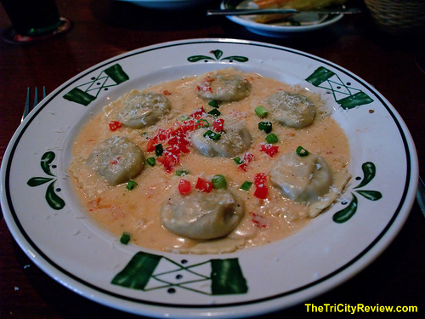
Meals
~20-25 minutes
Confirm every meal
Ask how everything looks
Check for drink refills

Slide 11
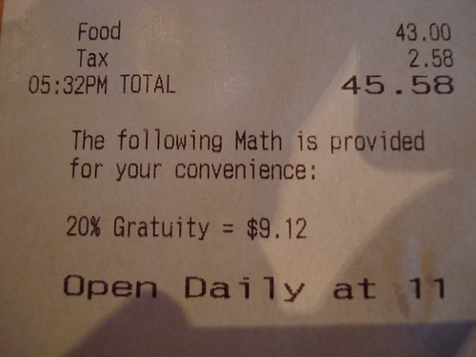
Bringing the check
~50 minutes for dinner
Offer dessert
Clarify that the meal is at their pace
Set it down out of the way
Return within two minutes to check on them

Slide 12
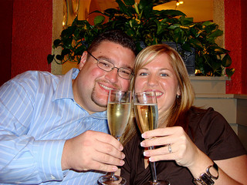
Thank you For coming in!
“I hope you enjoyed everything, we’ll see you soon.”

Slide 13
Final Pointers
Consider yourself a food consultant rather than a server
Check on tables at least 10-12 times a meal
Identify your fellow colleagues
Remember:
They chose your restaurant
They are contributing to your salary
Be comfortable and respect yourself, as well!

Slide 14
Image Credits
All images are taken from Creative Commons and are able for use.
Server http://www.flickr.com/photos/13836948@N04/4336641661/in/photolist-7BdqtP-9pmwmX-9ppye9-9pmwjp-9ppygm-9ppyd9-7QVSSH-aGkB9Z-bHgF2D-bumS97-bumSkA-bHgFsi-bumRKs-bHgE2r-bHgDDB-bHgEoM-bumSLW-bumRn1-7TBsiE-7TBsgS-9qKAfx-9qNzKS-9qNzFC-9qNzTb-9qNzVw-862oG4-au7Pqa-8F9ePN-8F65Kg-8F9bD1-8F63pT-8F5ZwD-8F9cjf-edzG1Z-edFnhy-edzGdc-edFnCd-edzGDr-edFnvm-edzGwP-edFmPq-edzH4B-edFnz5-edFnso-edFnpu-bBiADF-9Nciju-9uAaMk-9uDbgs-9uAaNF-9N9xtc
Wine http://www.flickr.com/photos/j_benson/3664300888/sizes/m/in/photostream/
Ravioli http://www.flickr.com/photos/thetoad01/3294022312/sizes/m/in/photolist-625J59-676LQC-6ctyUe-6szpKg-6sDvRQ-6zNuZw-6B7JdL-7i6fjA-9pmwmX-9ppye9-9pmwjp-9ppygm-9ppyd9-7QVSSH-aGkB9Z-cymn8s-bHgF2D-bumQYQ-bumS97-bumSkA-bHgFsi-bumRKs-bHgE2r-bHgDDB-bHgEoM-bumSLW-bumRn1-7TBsiE-7TBsgS-9qKAfx-9qNzKS-9qNzFC-9qNzTb-9qNzVw-862oG4-au7Pqa-7BdqtP-8F9ePN-8F65Kg-8F9bD1-8F63pT-8F5ZwD-8F9cjf-edzG1Z-edFnhy-edFnCd-edzGdc-edzGDr-edFnvm-edzGwP-edFmPq/
Salad http://www.flickr.com/photos/agroffman/4444091713/sizes/m/in/photolist-7LH8CV-bHgF2D-bumS97-bHgFsi-bumSkA-bHgE2r-bHgDDB-bumRKs-bumSLW-bHgEoM-bumRn1-cbNaDm-8jiVxS-awwPBm-7LuHwd-7LqJiP-7LuHMu-e6bMrc-dYsHsS-dYsHq5-dMwW9w-dMwWDu-ed8g8i-aQDdC4/
Check: http://www.flickr.com/photos/78199693@N00/2698598292/in/photolist-57t2fL-5pYBUT-5wDiM6-5CyNCo-5SSzLw-6atvWq-6bJboK-6epLTM-6jZNaA-77zUJm-7bV4sk-7dxz43-7fMxVa-7hi4Nj-7x9R6T-7xdCYj-7VTj6K-9k6bsF-9xySZe-dMTuBj-9C8DNo-9k7Wk1-bXm2yr-8MooN8-8d4hF9-7ZFogi-7ZJynS-7ZJxVS-9rWCxZ-8bsJUK-9C5HRV-9mxRXT-7DD5Vn-9C8DXu-7RRxny-b3XFAP-8hMDyT-dkjGGz-dkjJaz-dkjHD8-dkj32t-dkjwmH-dkj19X-dkj92x-dkjWWT-dkjPhN-dkjLmV-dkjUAH-dkjQKT-dkjrqN-dkjZGn
Couple http://www.flickr.com/photos/49503134679@N01/2958792572/in/photolist-5vszX3-5zLZi8-5zLZjz-5LxrMv-625J59-676LQC-6ctyUe-6szpKg-6sDvRQ-6zNuZw-6B7JdL-7i6fjA-cymn8s-bumQYQ-9pmwmX-9ppye9-9pmwjp-9ppygm-9ppyd9-7QVSSH-aGkB9Z-bHgF2D-bumS97-bumSkA-bHgFsi-bumRKs-bHgE2r-bHgDDB-bHgEoM-bumSLW-bumRn1-7TBsiE-7TBsgS-9qKAfx-9qNzKS-9qNzFC-9qNzTb-9qNzVw-862oG4-au7Pqa-7BdqtP-8F9ePN-8F65Kg-8F9bD1-8F63pT-8F5ZwD-8F9cjf-edFnhy-edzG1Z-edFnCd-edzGdc

